Slide 1
Aspect Based Sentiment Analysis of Airline Tweets

Slide 2





Who are we – We are the
Jose Bordon Data Scientist
Ryan Kirby Control Manager
Shruti Korada Business Analyst
Zachary Stockmal Software Engineer

Slide 3







The AI Canvas
What task/decision are you examining?
We are examining tweets and deciding how to analyze the aspect or topic of that tweet as well as the customer’s sentiment towards it.
We want to give the company an evaluation of the topic, so they can task out whether it requires remediation.
Prediction
Judgment
Action
Outcome
Predict whether a tweet towards an airline has positive or negative sentiment, and what aspect caused that.
Identifying a truly negative tweet can give the company insight on where their efforts should be placed and quickly resolved. Falsely identifying a negative tweet as positive could leave the company with more unsatisfied customers.
The airline can then identify the source of many of their negative tweets and work to resolve it, as well as improve their brand’s standing on social media (restart a service, address a delay, etc.)
When an airline acts on the aspect presented that was negative, we expect to see if in a different timeframe the negative sentiment towards the aspect go down. (example: 100 people hate the food during 2021, they change the food in 2022, then we only see 20 people hate the food)
Training
Input
Feedback
Our sentiment model will stay the same, but our aspect identifying model will stay trained on a historical record of the tweets before hand with generic clusters setup. As the prediction machine is deployed, we will receive more data from the newer tweets that come in, and have it adjusted to the whims of the public over time.
A steady stream of tweets about the airline will generate our aspects and sentiment analysis for the model to work from. Gaps in knowledge from the tweets can be supplemented with flight records and other public data relating to the time period. (holidays, other social media, etc.)
On a monthly cycle we will package all the tweets run through our model with their respective sentiment prediction and aspect identified and outsource the validity of models predictions. If we are happy with our positive rate we will let the model continue as is, if not we will have to retune our model with the new data
How will this AI impact on the overall workflow?
The goal of this AI is reducing the workload of social listening for a company. Customer service representatives will need to be retrained to identify the aspects and which ones require escalation or remediation. This AI will give airline companies a more efficient and effective method of finding the issues their company is causing for the customers. Usually customer surveys go unanswered, but tweets are more easily accessible making it a better identifier of a company’s standing on social media, and what issues need their attention.
© Agrawal, Gans, Goldfarb 2019

Slide 4


End to End Workflow
API
Train Model
Positive
Neutral
Negative
Tweet Database
✅
Final Model
Preprocessing
Luggage
Customer Service
Delay
Create Clusters
✅
Feedback

Slide 5
End to End Workflow
API
Train Model
Positive
Neutral
Negative
Tweet Database
✅
Final Model
Preprocessing
Luggage
Customer Service
Delay
Create Clusters
✅
Feedback

Slide 6
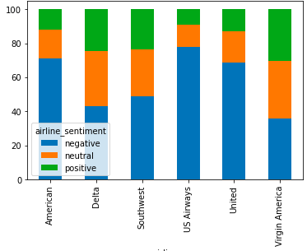
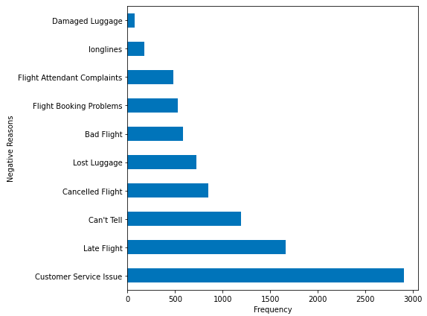
Our Data
Twitter is a social network where users can post “tweets”, tweets are short post of up 140 characters.
The data set that we used consistent of approximately 15,000 tweets from users that have an @airline in their text. Airlines consist of United, Southwest, Delta, US Airways, American, and Virgin America
Tweet
Datapoint
Airline | Tweet | Sentiment | Aspect | Other Cols. But not used
United | @UnitedAirlines_Direct flight booked was changed no notification with lay over. I purchases seats, not h……..s | Negative | Customer Service | ………
Airline Sentiment
Aspect
62% non-null
Example

Slide 7
End to End Workflow
API
Train Model
Positive
Neutral
Negative
Tweet Database
✅
Final Model
Preprocessing
Luggage
Customer Service
Delay
Create Clusters
✅
Feedback

Slide 8

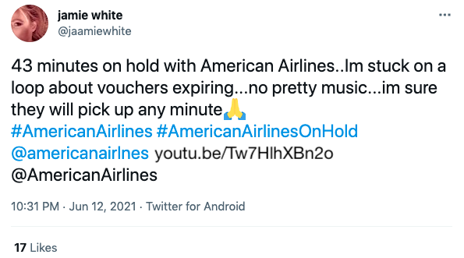
Data Scrubbing
Tweets contain portions of text that aren’t related to the sentiment or aspect and have to removed
Remove Tagged Users
HTML Decoding
Remove any links
Remove any characters that aren’t letters
Remove Stop Words
Stemming
Pre
43 minutes on hold with American Airlines..Im stuck on loop about vouchers expiring..no pretty music..im sure they will pick up any minute&#65; #Americanairlines#AmericanAirlinesOnHold@americanairlnes youtu.be/Tw7HlhXBn2o @AmericanAirlines
Post
minute hold American Airlines Im stuck loop voucher expire no pretty music im sure they pick up minute Americanairline AmericanAirlinesOnHold

Slide 9
End to End Workflow
API
Train Model
Positive
Neutral
Negative
Tweet Database
✅
Final Model
Preprocessing
Luggage
Customer Service
Delay
Create Clusters
✅
Feedback

Slide 10
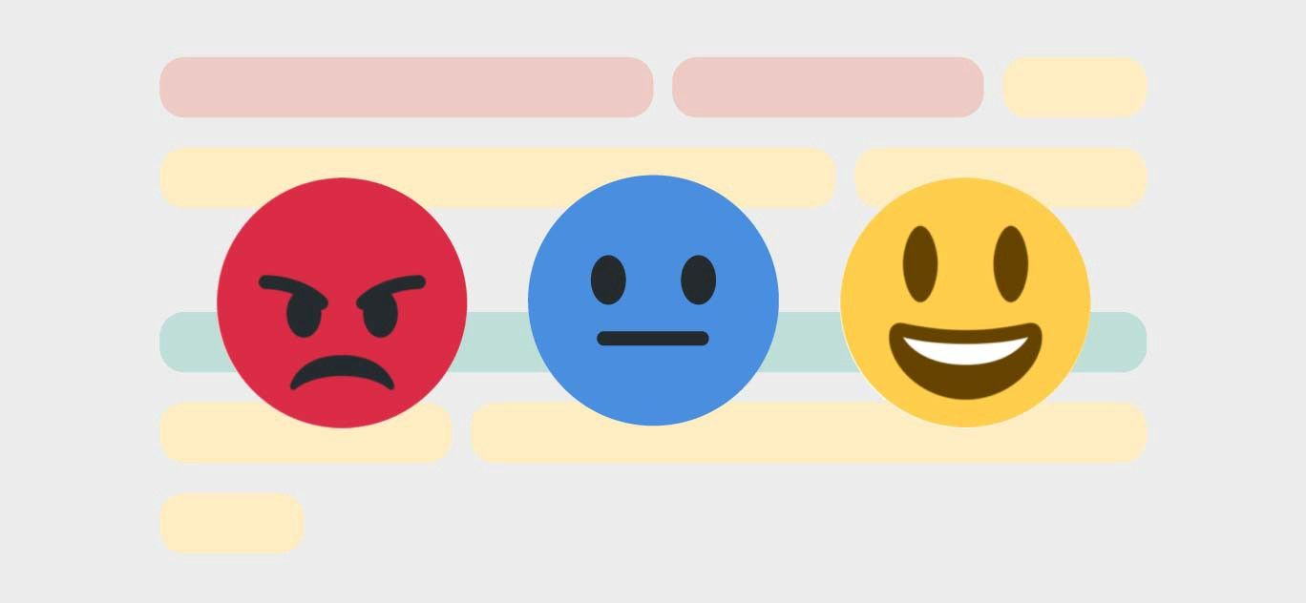

Sentiment Analysis
Baseline Analysis – Naïve Bayes - 55% Accuracy
VADER - SentimentIntensityAnalyzer (nltk): 65%
Precision: 0.898
Recall: 0.504
Accuracy: 0.653
F1 Score: 0.646
Hugging Face (BERT): 79%
Precision: 0.939
Recall: 0.711
Accuracy: 0.790
F1 Score: 0.809
Textblob x NaiveBayesAnalyzer (nltk): 69%
Precision: 0.775
Recall: 0.716
Accuracy: 0.692
F1 Score: 0.744
Fine-tuned Hugging Face (BERT): 89% on the test subset.
With another airline tweets dataset:
Precision: 0.853
Recall: 0.738
Accuracy: 0.791
F1 Score: 0.791

Slide 11
End to End Workflow
API
Train Model
Positive
Neutral
Negative
Tweet Database
✅
Final Model
Preprocessing
Luggage
Customer Service
Delay
Create Clusters
✅
Feedback

Slide 12
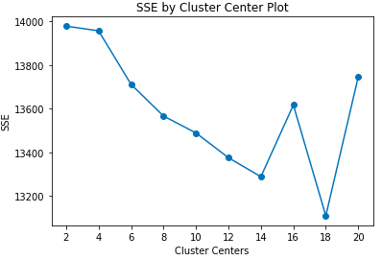
Aspect Building
Due to aspects being unsupervised, we used an elbow curve to measure the inertia when adding more clusters to decide an appropriate amount
Cluster 1
Cluster 2
Cluster 3
Cluster 4
Plane Sit Hour Gate
Waited
Why
Boarding
Help
Bag
Change
Time
Know
Working
Booking
Updates
Very
Safe
Okay
Got
Yes
respond
Because
Phone
Want
Thanks
Great
Awesome
Appreciate
Follow
Sent
Good
Left
Just
New
Passengers
Please
Seats
Stop
Delayed
Late
Flightr
Missed
Connecting
Min
hrs
Cluster 5
Cluster 6
Cluster 7
Cluster 8
Need
Trying
Days
Like
Guy
Check
Hold
Cancelled
minutes
Service
Customer
Worst
Terrible
Today
Poor
line
Rebook
Tomorrow
Dfw
Reschedule
ticket
At 8 clusters we get little improvement in inertia
Due to overlap between clusters, some clusters we’re merged resulting in 4 clusters
Customer Service
Ongoing Flights
Booking
Luggage
Wait time

Slide 13
End to End Workflow
API
Train Model
Positive
Neutral
Negative
Tweet Database
✅
Final Model
Preprocessing
Luggage
Customer Service
Delay
Create Clusters
✅
Feedback

Slide 14
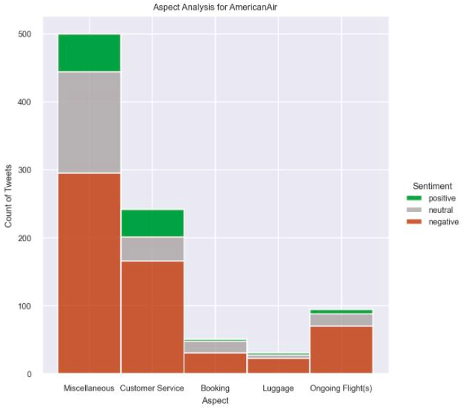
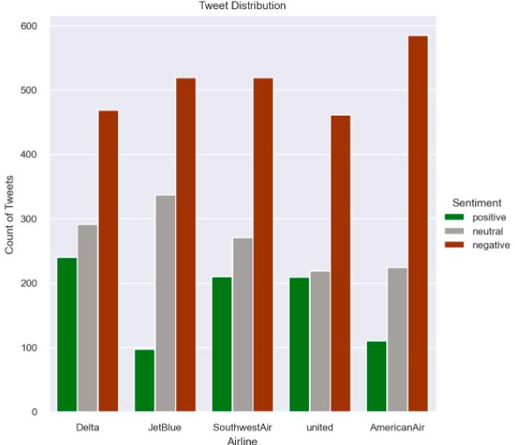
Demo Part 1
Aspect Analysis for American Air
Tweet Distribution

Slide 15
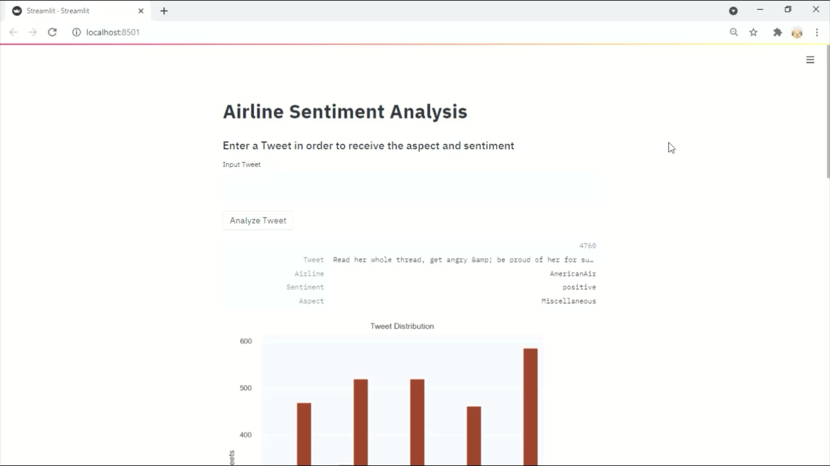
Demo Part 2

Slide 16
Recommendation
Fine tuning the hugging face model showed drastic improvements in sentiment detection comparatively to the baseline. If the model we’re to deteriorate with time, we are confident that minor tweaks could keep its current accuracy.
Aspect clustering was not as straight forward and required a lot of manual intervention and as of now would not be sustainable. Could outsource this portion
When customer service is using our model they can continually add input whether a tweet is correctly classified, adding to our training data over time
Lastly, we would love to expand our original training dataset to a more current timeframe. With Covid-19 changing travel so drastically there may be new things that aren’t covered with our training set.

Slide 17
What else could we do
Each tweet being put to more than one cluster, multi-aspect analysis
When more data is added, incorporate a seasonality affect
Dynamic Clusters

Slide 18
Conclusion
Build a Social Listening Tool
- Inform customer service on customer complaints are trending
- discover new pockets of negative sentiment, or new topics (e.g. masks)
- benchmarking against other companies (i.e. where do we perform better, what should we advertise?

